Slide 1
AMAZON SALES ANALYSIS

Slide 2
Business Problem
In the highly competitive e-commerce landscape, effective sales management is critical for reducing costs and maximizing profits. Amazon, as a leading e-commerce platform, must continuously analyze and optimize its sales strategies. This project aims to extract, transform, and load (ETL) Amazon's sales data to uncover trends and key metrics that can inform strategic decisions. By analyzing month-wise, year-wise, and combined yearly-month-wise sales trends, and identifying meaningful relationships between various attributes, Amazon can enhance its distribution methods, improve customer satisfaction, and maintain its competitive edge in the market.

Slide 3
Details of Data
Order ID: This column defines the unique identifier for each order placed on Amazon.
Product: It shows the name of the product purchased.
Category: This column defines the category to which the product belongs.
Order Date: The date on which the order was placed.
Ship Date: The date on which the product was shipped.
Units Sold: The number of units sold in each order.
Unit Price: The price of a single unit of the product.
Total Revenue: The total revenue generated from the sale of the units (Units Sold * Unit Price).
Total Cost: The total cost incurred for the units sold.
Total Profit: The total profit made from the sale (Total Revenue - Total Cost).

Slide 4
INSIGHTS
Mean Sales: The average sales value might be skewed by high values dueto a high
standard deviation and range.
Median Sales: Lower than the mean, indicating that half of the sales are below average,
suggesting right-skewed data.
High Variance: Indicates a wide spread of sales data.
Positive Skewness: Data distribution has a long right tail.
High Kurtosis: Leptokurtic distribution suggests data has heavy tails and extreme values (outliers).

Slide 5
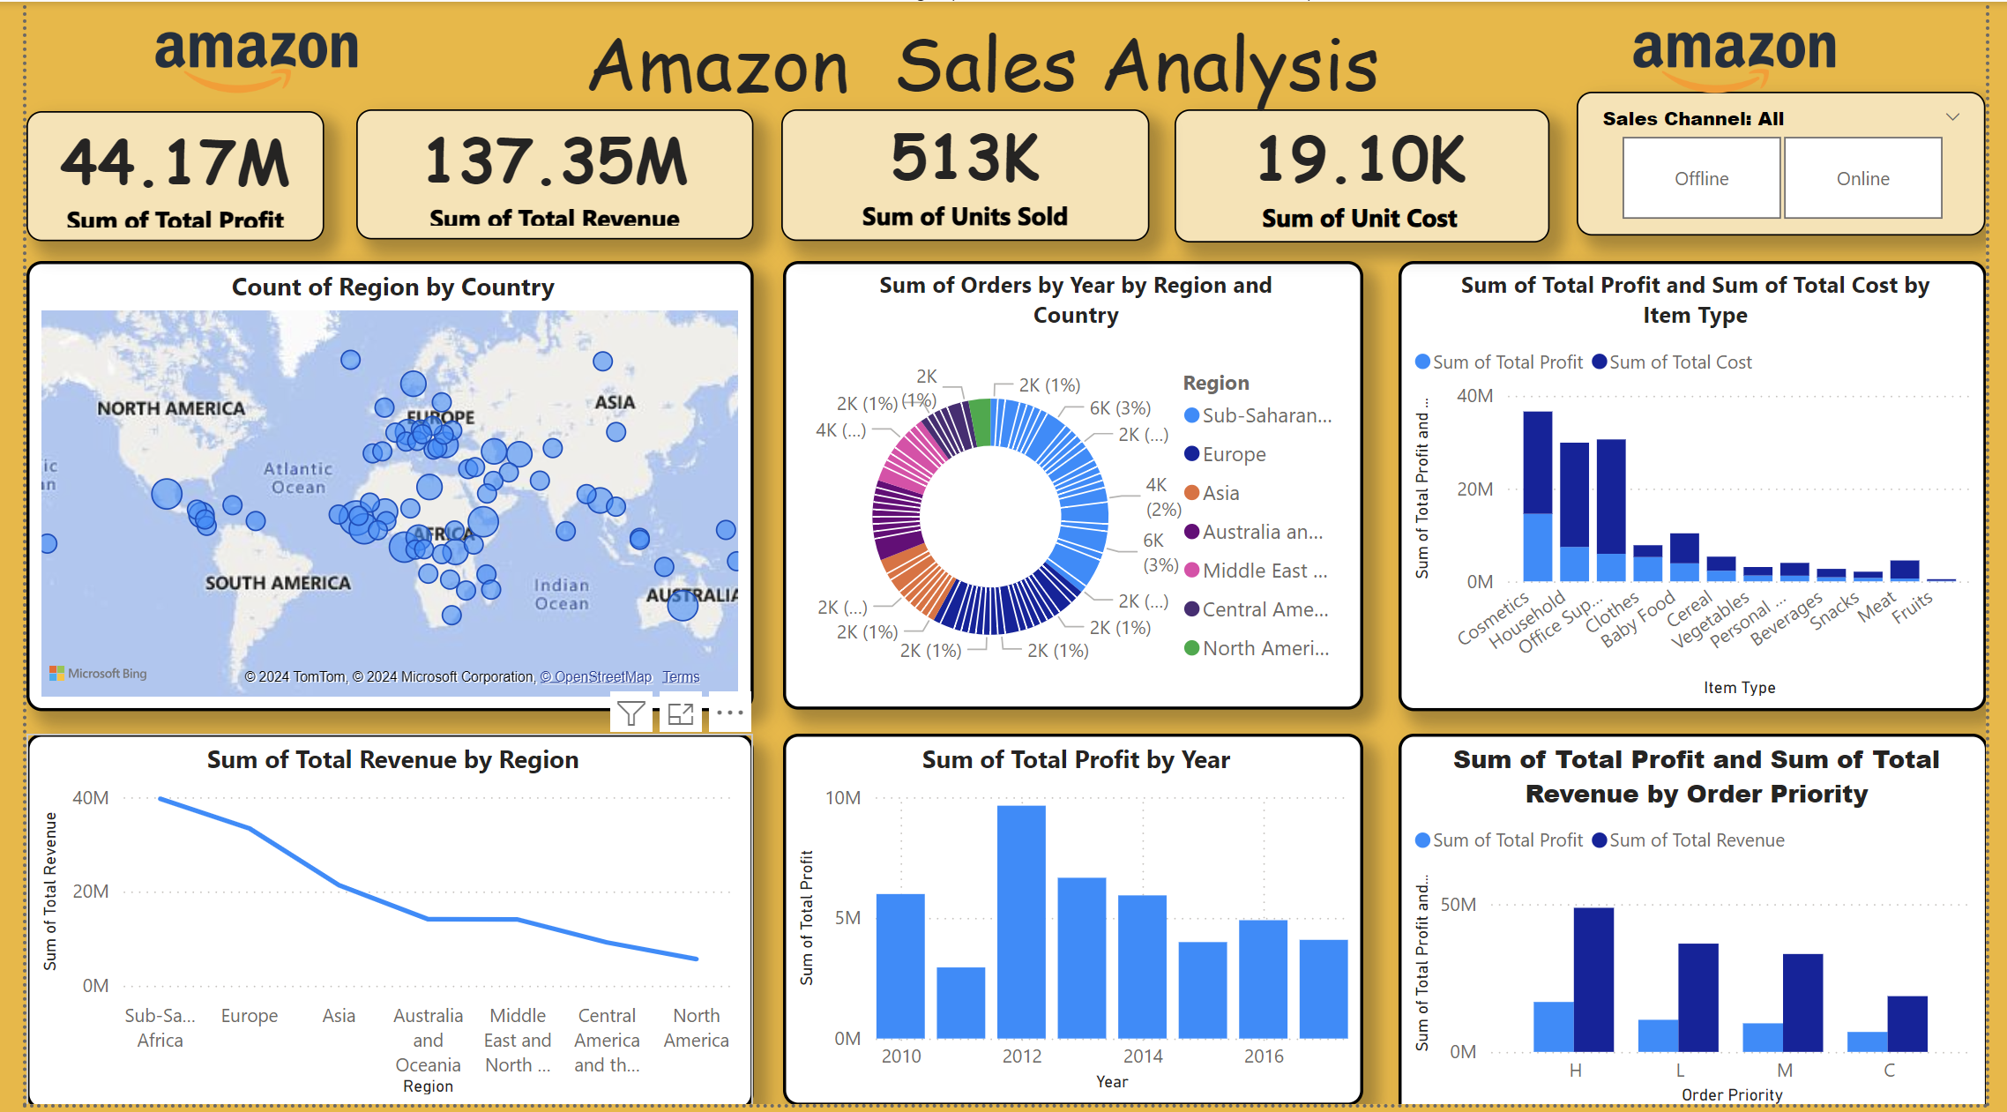
MY DASHBOARD

Slide 6
THANK YOU

